Slide 1
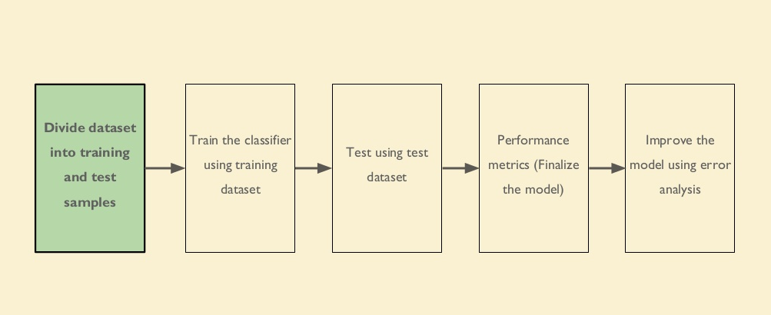
Steps:

Slide 2

Decision Tree
As the name suggests it is a classifier based on a series of logical decisions, which resembles a tree with the branches..
A decision tree is used for multi-dimensional analysis with multiple class.
It is characterized by fast execution time and ease in the implementation of the rules.
Popular Decision Tree Algorithms:
1.CART (Classification and Regression Trees) — This makes use of Gini impurity as metric.
2.ID3 (Iterative Dichotomiser 3) — This uses entropy and information gain as metric

Slide 3
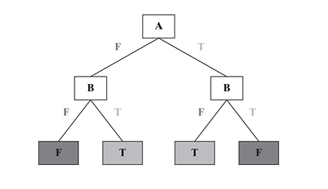
Decision Tree Structure

Slide 4
Important Points in Tree Modelling
A tree is a collection of entities called Nodes
The edges in trees connects the nodes
Every node will have its own value or data, and it might or might not possess child node.
If a root node is connected to any other node, that root will become the Parent node and the connected one will be child node.
Terminal nodes are the nodes without children. Like real trees, we have the roots, branches and finally leaves

Slide 5
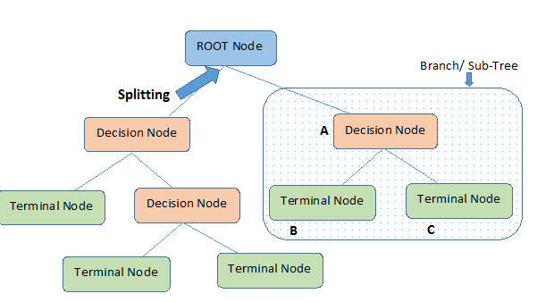

Slide 6
Tree Terminology
Root Node : The node at the top of the tree
Child Node : One node is child node of the other if it is below from the node(away from root node)
Parent Node : One node is parent node of the other if it is above of the node(closer to the root node)
Leaf Node : Node which do not have any child node
Edge : Connection between two nodes
Degree : Count of subtree of any node
Splitting : It is a process of dividing a node into two or more sub-nodes
Pruning : When we remove sub-nodes of a decision node, this process is called Pruning.
Depth : It is the length of the path to its root.

Slide 7
Implementation
Entropy --> Measure of the impurities
Information Gain -->Entropy(S) - Weightedavg * Entropy of each feature..
Entropy --> summation (i =1 to c) -plog(base2)p(i)
where c rep the number of diff class labels and p refers to the proportion of values falling into the ith class label.
Gini Index:
Gini(E) = 1 - (Σj = 1 to c)p^2 j
Gini impurity tends to isolate the most frequent class in its own branch of the tree,
While entropy tends to produce slightly more balanced trees.

Slide 8
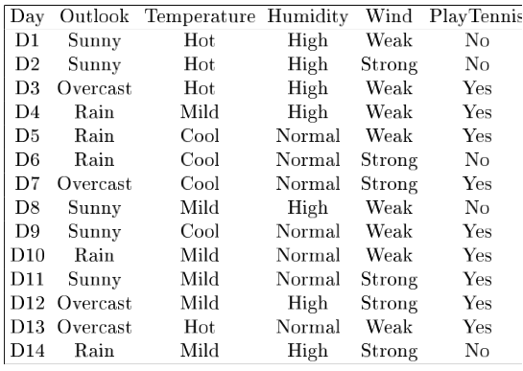
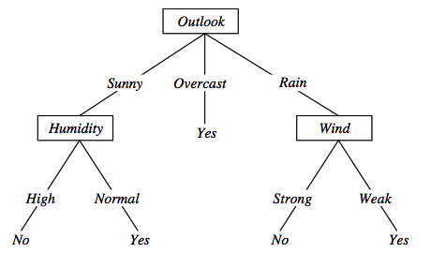
Sample Representation

Slide 9
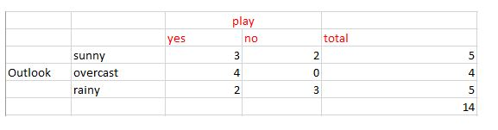
Gini(S) = 1 - [(9/14)² + (5/14)²] = 0.4591
Gini(S, outlook) = (5/14)gini(3,2) + (4/14)*gini(4,0)+ (5/14)*gini(2,3) = (5/14)(1 - (3/5)² + (2/5)²) + (4/14)*0 + (5/14)(1 - (2/5)² + (3/5)²)= 0.171+0+0.171 = 0.342
Gini gain (S, outlook) = 0.459 - 0.342 = 0.117
Gini gain(S, Temperature) = 0.459 - 0.4405 = 0.0185
Gini gain(S, Humidity) = 0.459 - 0.3674 = 0.0916
Gini gain(S, windy) = 0.459 - 0.4286 = 0.0304

Slide 10
Steps to Follow
Begin with your training dataset, which should have some feature variables and classification or regression output.
Determine the “best feature” in the dataset to split the data on; more on how we define “best feature” later [selecting the root node]
Split the data into subsets that contain the possible values for this best feature.
This splitting basically defines a node on the tree i.e each node is a splitting point based on a certain feature from our data.
Recursively generate new tree nodes by using the subset of data created from step 3.
We keep splitting until we reach a point where we have optimized, by some measure, maximum accuracy while minimizing the number of splits / nodes.

Slide 11
Merits and Demerits
Merits
Easy Interpretation
Useful in Data Exploration
Data Cleansing
Outliers
Data Types is not a constraint
Non Parametric Method
Demerits
OverFitting
Computationally expensive to train
Large trees are complex to understand
Thus Decision Tree can be applied on a dataset in which there is a finite list of attributes and each instance stores a value for that attribute.

Slide 12


